Slide 1

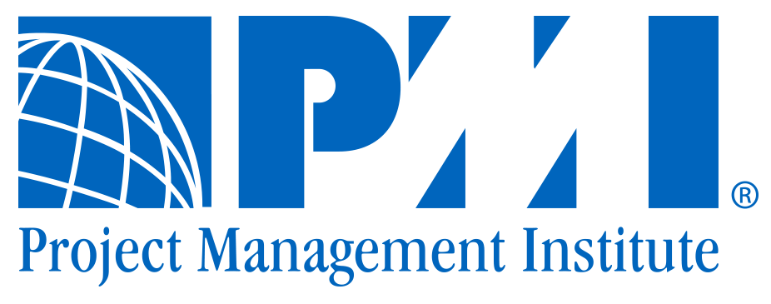
Blockchain & Distributed Ledgers
PMI Event, 2018-07-05
Johannes Ahlmann, fluquid.com
johannes@fluquid.com

Slide 2

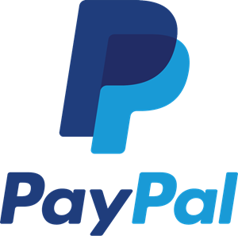





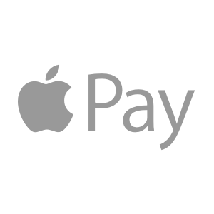
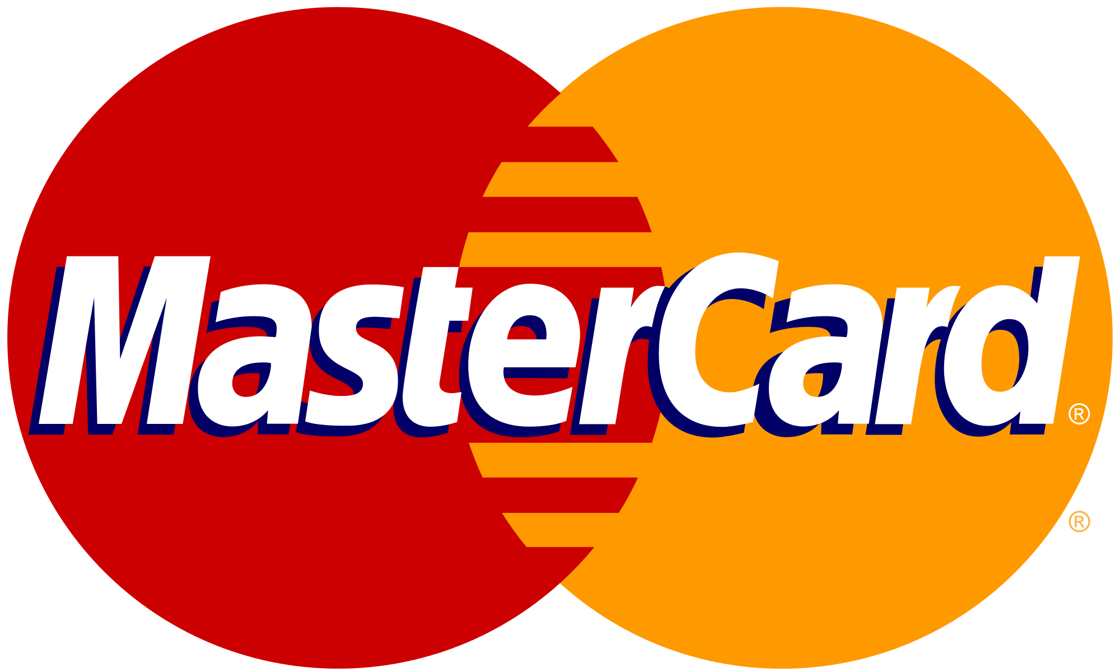
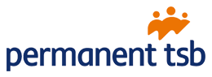
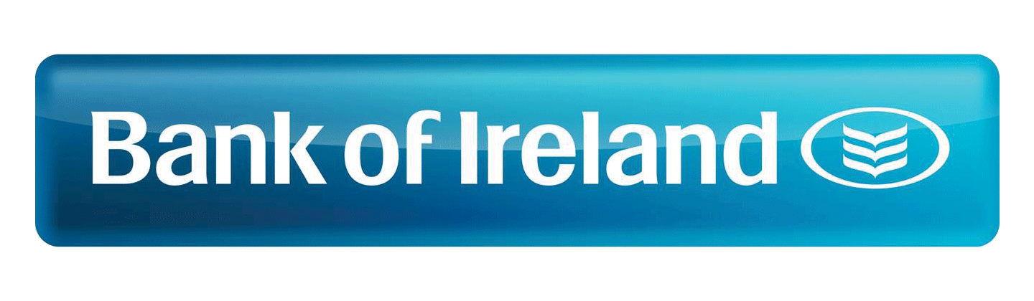

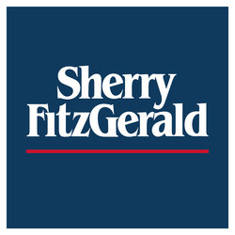





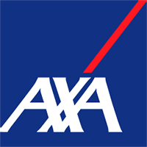

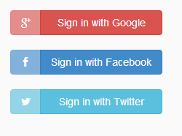







When we interact/transact with others, we often delegate Trust to Intermediaries
Betting
Social
Payments
producer,
provider,
seller,
lender
Banks,
Insurances
Property
Titles
consumer,
recipient,
buyer,
borrower
Reviews
Market-
places
Identity,
Login
Pre-owned
Products

Slide 3
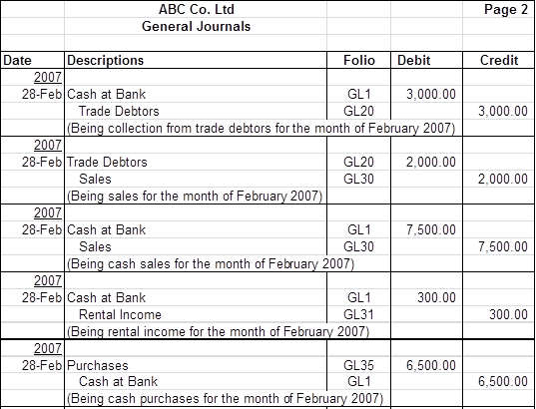
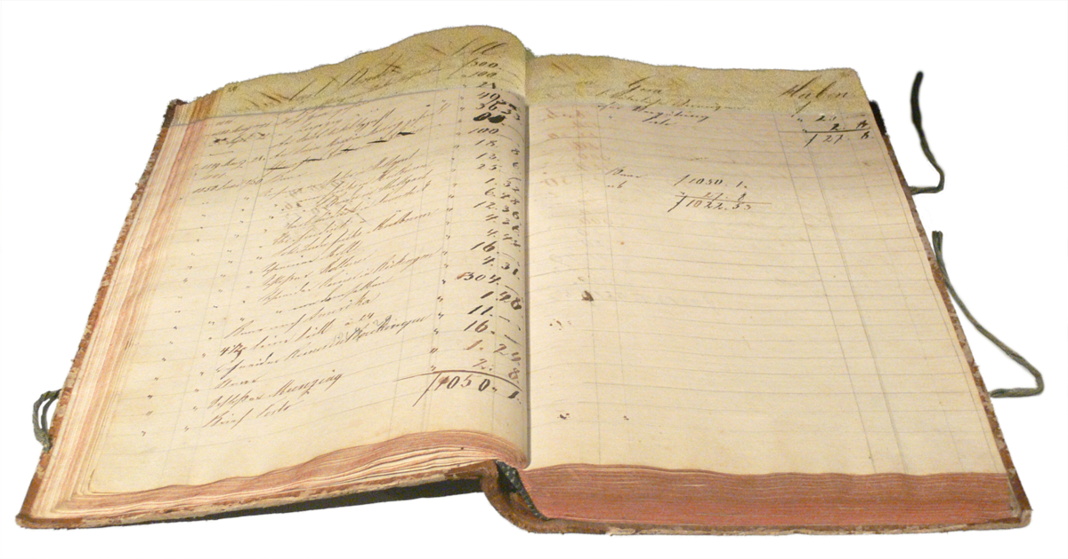
Ledger ~ Agreed State ~ Collection of Transactions
sources:
https://upload.wikimedia.org/wikipedia/commons/e/e6/Ledger.png
http://www.accountingcrashcourse.com/wp-content/uploads/2009/09/General-Journals.png

Slide 4
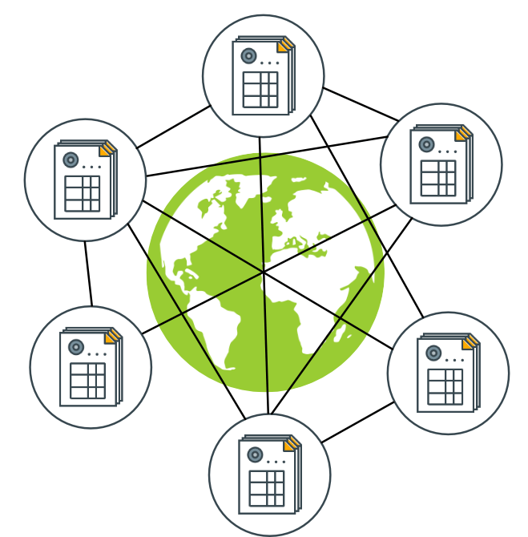
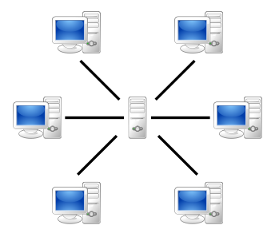
If we had a trusted Shared Ledger many of those Intermediaries would no longer be necessary
Shared, distributed Ledger
Immediate Consensus on "State of the World"
Tamper-Proof (Immutable)
Auditable
Transactions change the state
sources:
https://commons.wikimedia.org/wiki/File:Server-based-network.svg
http://www.gjermundbjaanes.com/img/posts/distributed_ledger.png

Slide 5
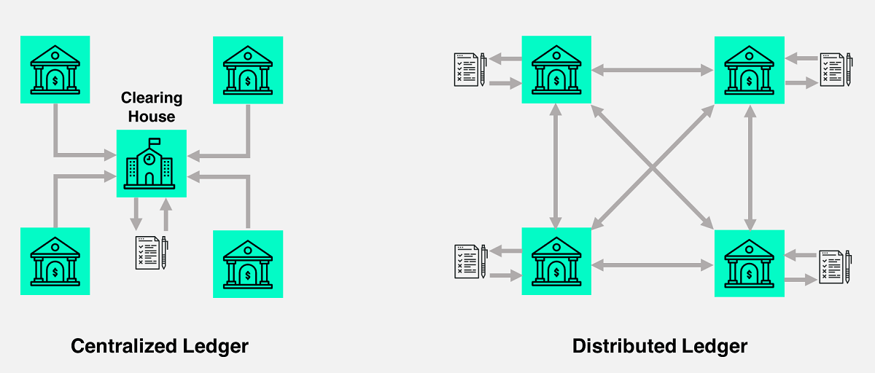
Centralized vs. Distributed Ledger
sources:
https://tradeix.com/distributed-ledger-technology/

Slide 6
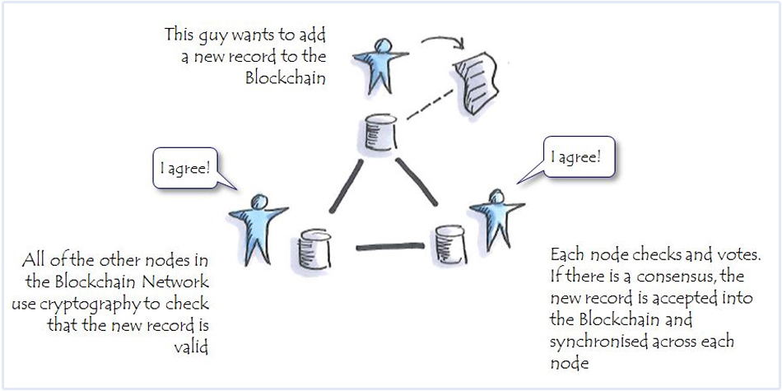
Consensus = Whatever is agreed upon Corollary: When participants can't reach consensus, a split of the participants occurs
sources:
https://www.zurich.com/en/knowledge/articles/2016/10/insurers-look-to-blockchain-to-better-serve-their-clients

Slide 7
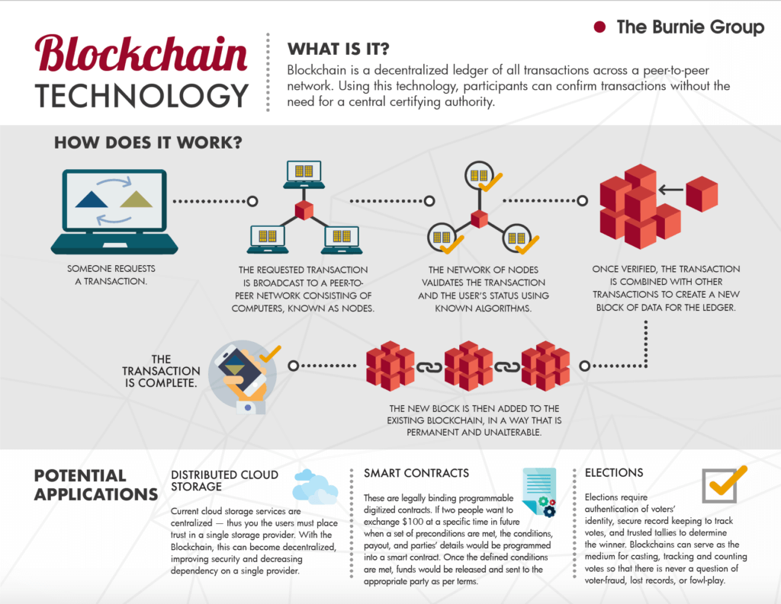
A day in the life of a Blockchain Transaction
source: https://www.burniegroup.com/infographic-a-look-at-blockchain-technology/

Slide 8
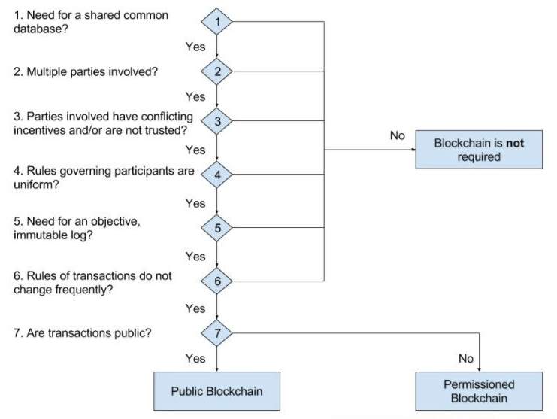
Criteria for Blockchain Adoption
sources: https://cdn-images-1.medium.com/max/856/1*QMK4h8SzoMNFLE7eDQWPew.jpeg

Slide 9
A Consortium Blockchain can address some Challenges Companies may find with Public Blockchains
Public | Consortium
Data is Public | Privacy, Confidentiality
Transactions are Public | Private Channels
Pseudonymous | Known participants
Anyone can join | Permissioned
Anyone can access | Permissioned
Trustless Nodes | Semi-Trusted Nodes
Low tx/s | High tx/s
 | GDPR Compliance
Group of known, semi-trusted parties
Access granted by members
Consensus ~ majority vote (BFT)
Consensus can withstand 1/3 of malicious nodes
Easier Governance

Slide 10
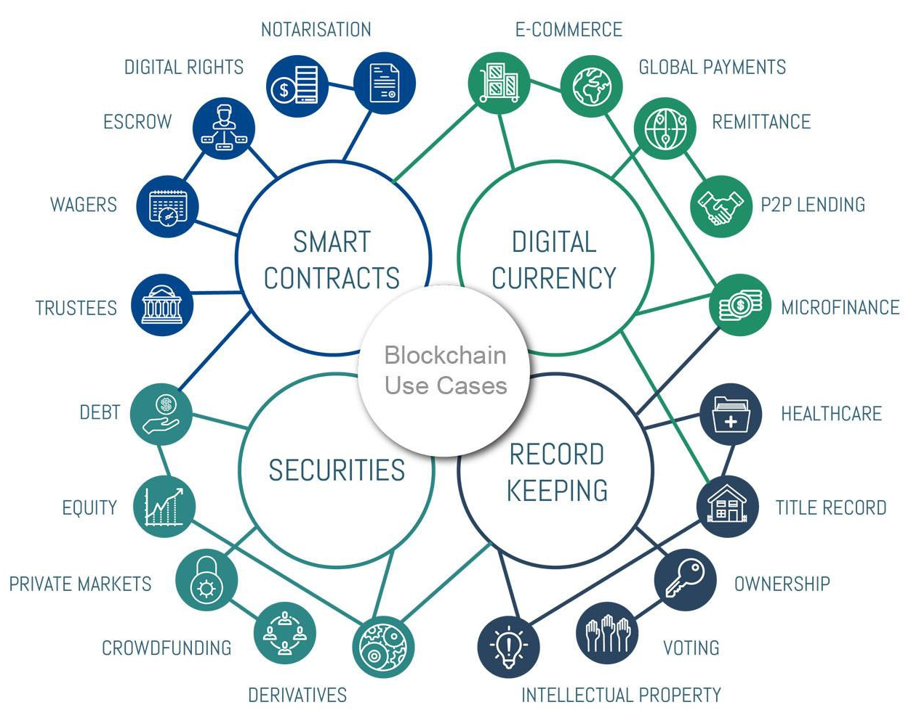
What are some of the Blockchain Use Cases for Companies?
Data Exchange between multiple parties
End-to-End Supply Chain Transparency
Product Traceability
Marketplaces, Trading
Clearance & Settlement
Public Registries
https://medium.com/@sergiomarrero/6-emerging-categories-for-blockchain-use-cases-4650f824d130

Slide 11
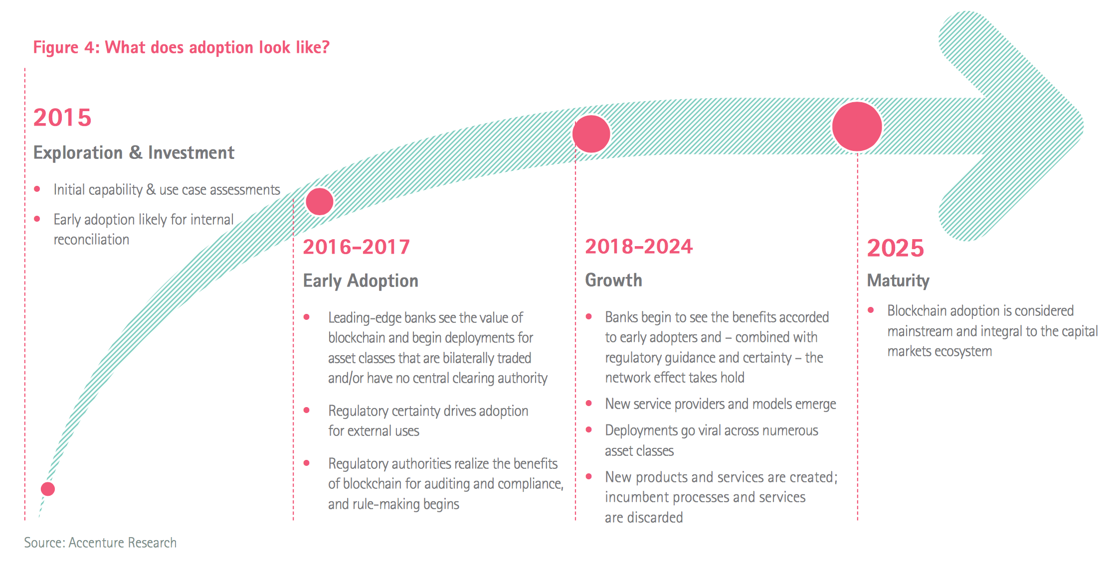
There is large interest in Blockchain Adoption, with many projects underway
Maersk | cargo tracking
Port of Antwerp | container handling
Walmart | supply chain transparency
Airbus | jet plane parts tracking
UPS | supply chain transparency
FedEx | customer dispute resolution
Australian Securities Exchange | clearance & settlement
Credit Suisse | syndicated loans
Dubai Land Dept. | land registry

Slide 12
Thank you, any questions?

Slide 13
Q & A
What is the implementation and running cost of a blockchain project?
I believe the running cost of a blockchain project, and even the development cost will be similar to traditional software projects.org, dev, rollout, stakeholders, requirements, etc.)
Isn't distributed data inherently less secure than centrally stored data?
Yes, data stored centrally has a smaller attack surface than distributed data
But the entity in charge of the central ledger has to be trusted
Possible to store only document fingerprints on blockchain (proof of existence)
Possible to use private channels in Hyperledger Fabric to reduce access to transaction participants
Permissioned blockchain gives the possibility to manage access permissions per document
- storage volume (store hashes = proof of existence; store off-chain i.e. IPFS)
- consensus vs. truth. what if people agree on the wrong thing?
- energy consumption, PoW
- low tx throughput
- consensus = whatever is agreed. when people disagree a blockchain split occurs.
- consensus in the face of malicious attackers is the whole point
- how do nodes get added in permissioned blockchain?

Slide 14
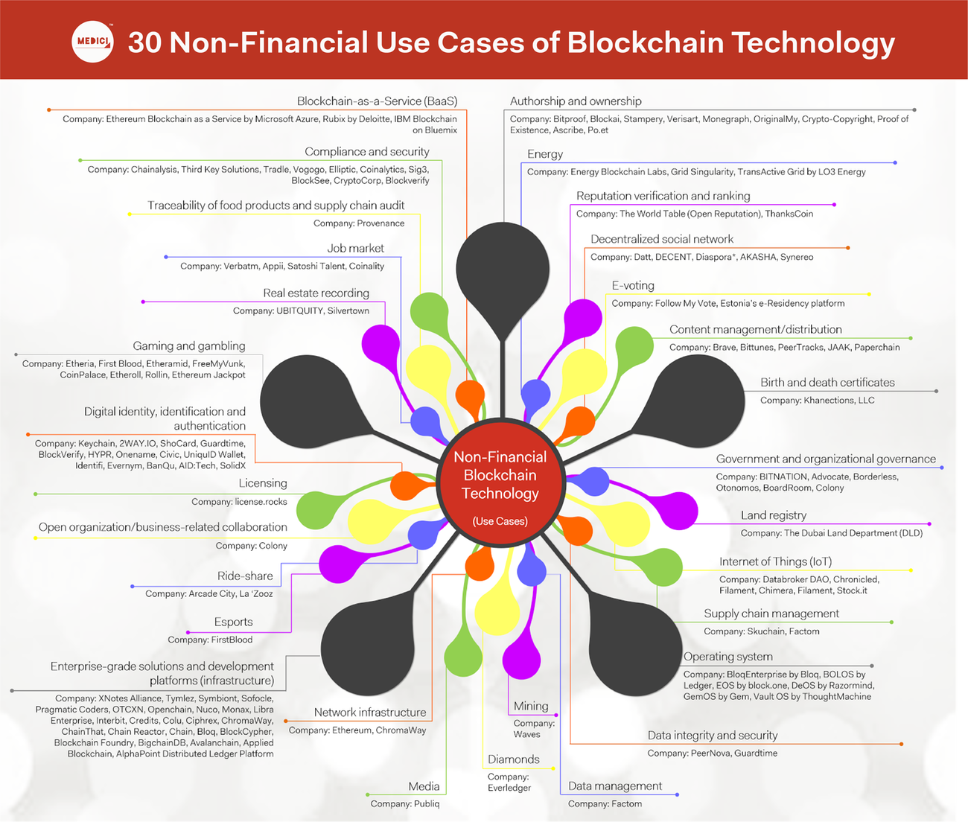
https://gomedici.com/30-non-financial-use-cases-of-blockchain-technology-infographic/

Slide 15
blockchain
crypto-currencies
digital assets
distributed ledger technology
democra-tization
fintech
legal
speculation
environ-mental
crypto-graphy
crypto-anarchy
disinter-mediation
Different Views
on Blockchain

Slide 16
artefacts
node
consensus rules, incentive
transaction
mining, minting
smart contract
ledger
state of the world
secret, public keys
p2p network
block
Blockchain Artefacts

Slide 17
Blockchain Properties
properties
throughput (tx/s)
fault
tolerance
privacy, confiden-tiallity
trusted, trustless
permission-less
verifiable, transparent
consensus scope
sybil,
double spend
tamper-resistant
anonymous, pseudo-nimous
censorship-resistant

